Slide 1

Why Switch to Weebly?
Elisabeth Green (McCullough Middle)
greenmcms.weebly.com

Slide 2
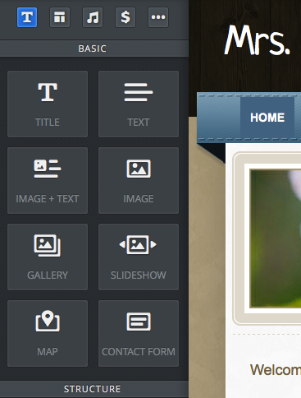
Drag and Drop Interface
You just drag any element over to your site.
You can insert slideshows, contact forms, downloadable files, and much more.
After you drop it in place, you can edit, move, or delete it.

Slide 3
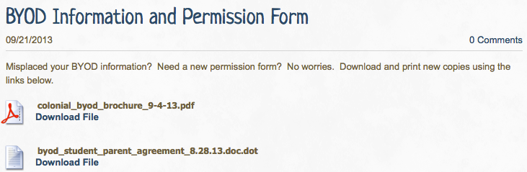
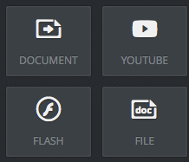
Easy to Upload Files
By dragging the file icon into your site, you can upload a file for students, parents or even other teachers to download.

Slide 4
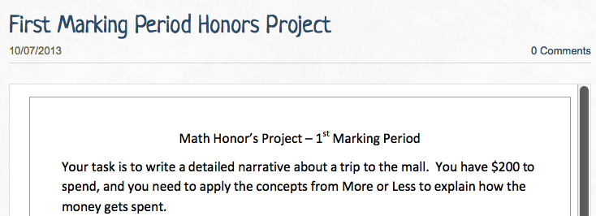
Viewable Files
Using the document button, you can upload a version that can be viewed without downloading. It even allows scrolling.

Slide 5
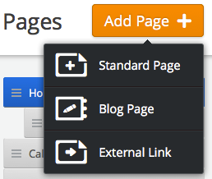
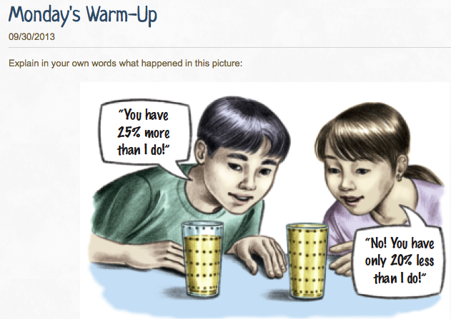
Blogs are Easy to Create
You can even include pictures!

Slide 6
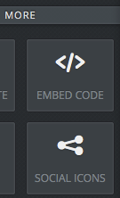
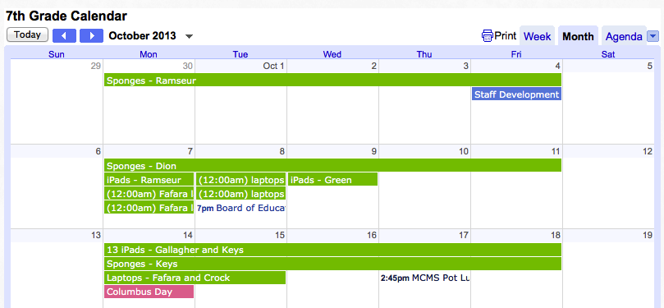
Embeddable Calendars
Multiple Google calendars can be combined and embedded together.

Slide 7
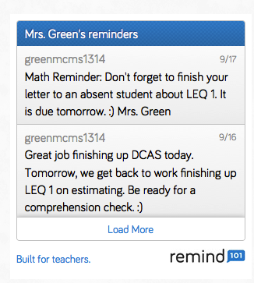
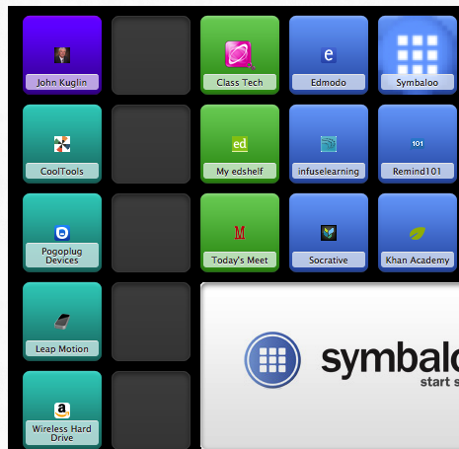
More Embedding
Remind 101 & Symbaloo

Slide 8
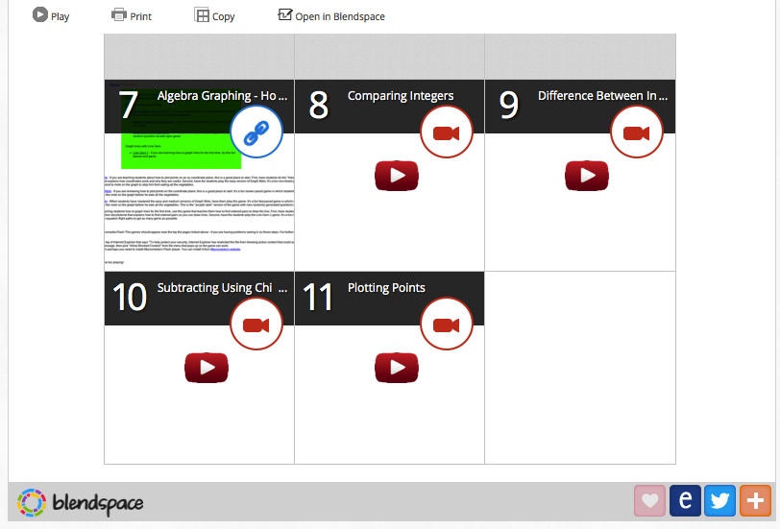
Blendspace (formerly EdCanvas)

Slide 9
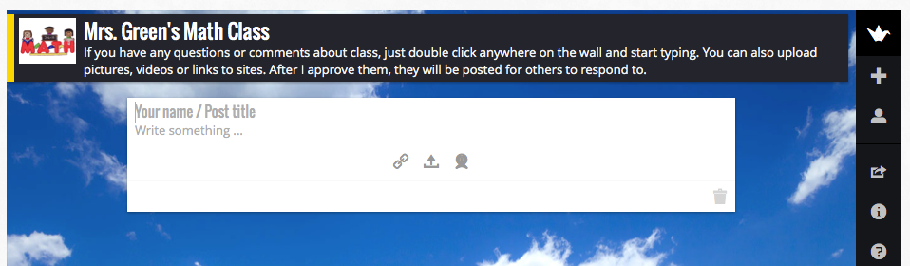
With an embedded version of Padlet, students can post quickly and easily. There are no extra sites for them to go to.

Slide 10
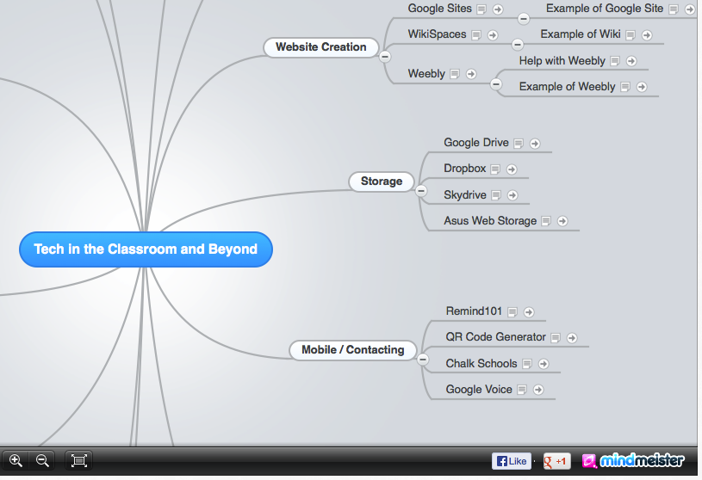
Mindmeister

Slide 11
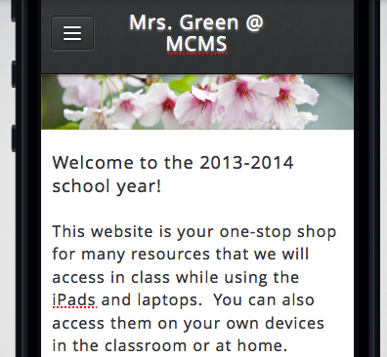
Mobile Version and App
A mobile version of your site is automatically created for you, so that it can be accessed more easily on phones. There is even a mobile app for teachers, so you can edit your blogs on the go.

Slide 12

Why is this all important?
A one-stop shop makes technology easier for students to use, and it saves time. Giving students one location for everything keeps them from feeling lost.

Slide 13
Make the Switch Today!
If you have a website that is user-friendly, it can grow with you, as you decide to add in new features for you and your students. You will then want to use it more and more.
For more ideas, visit my website at:
greenmcms.weebly.com

